Slide 1
Jinja2

Slide 2
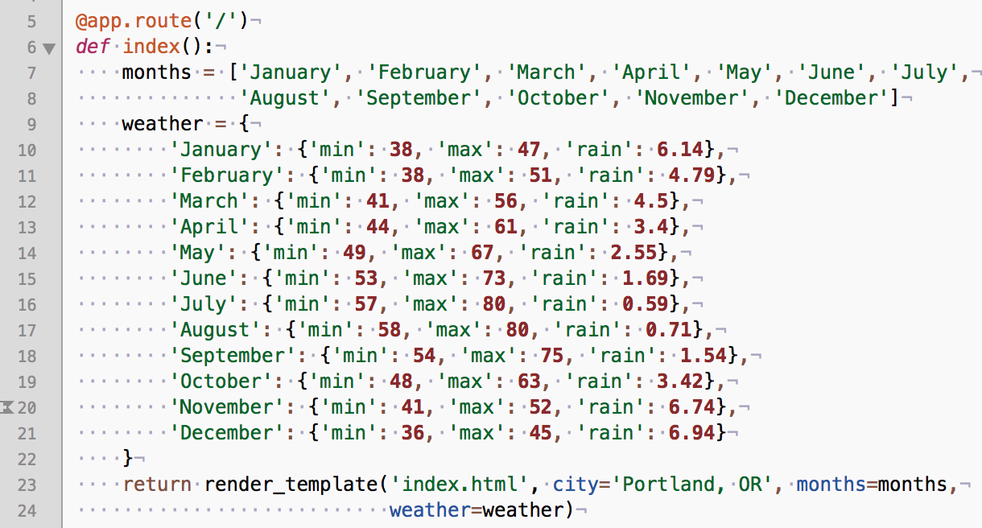
What is Jinja2
HTML template
Macro (block)
Programming language
Flask uses Jinja2 to raster web page
“render_template” method

Slide 3
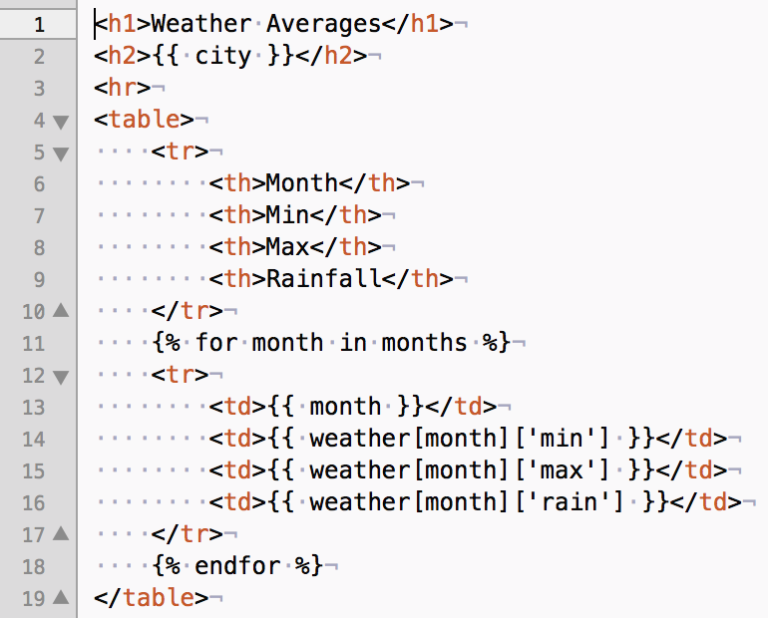

Dive into “index.html”
The html Jinja template is in “templates” directory (the default directory where Flask searches for the html files).
{{…}} means Jinja2 block.
In side it, “city” is a variable where the value is given by Flask.
{% .. %} means Jinja2 programming code

Slide 4
Jinja2 programming {% .. %}
Variable assignment
{% set hl = ... %}
{% set hl = weather[month]['max'] >= highlight['max'] %}
Loop
Similar to Python
{% for i in xyz %} … {% endfor %}
Selection
You can use the variable defined from some where.
{% if hl %}</b>{% endif %}

Slide 5
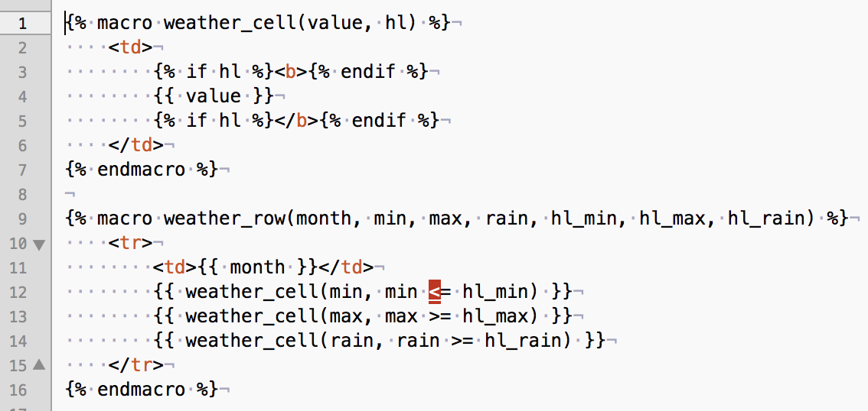
Jinja2 programming – macro (function)
You can think of “macro” as Python’s def
“{% macro name(parameters) %}”
You can invoke the macro by passing arguments

Slide 6
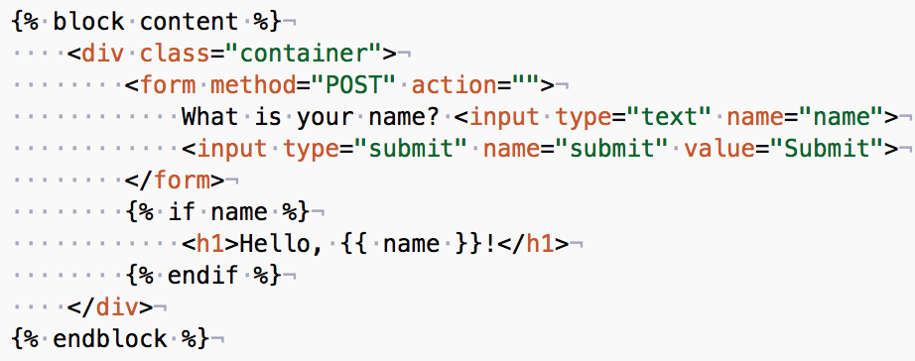
Jinja2 programming – block (or code block)
{% block NAME %}
It’s just a block of code that you can use.
DRY principle – Don’t Repeat Yourself.
Blocks can have Jinja2 programming components in them.
You can inherit other block using “extends”
{% extends “…” %}

Slide 7
Name space & third party library
You can use third party library, for example bootstrap to beautify your HTML.
{% extends 'bootstrap/base.html' %}
You can have a simpler namespace using “import”
{% import 'macros.html' as macros %}

Slide 8
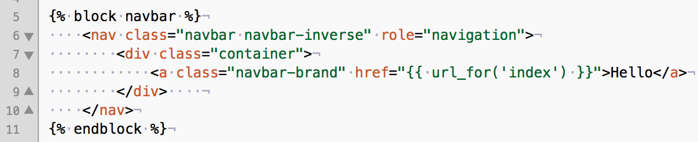
Jinja2 and Flask - {{ url_for(‘…’) }}
Flask keeps a map from URI (or path) to a Python function using Python’s decorator.
This maps ‘/’ (path) to ‘index’ function.
@app.route('/', methods=['GET', 'POST'])
def index():
url_for(‘index’) returns the reverse map results from ’index’ to path ‘/’.

